Slide 1
Forces
Content
5.1 Types of force
5.2 Equilibrium of forces
5.3 Centre of gravity
5.4 Turning effects of forces

Slide 2

Forces
Some words used in physics have a meaning that is more closely defined than the word’s meaning in everyday use.
There is multitude of words in the English language that represent force. Some examples: push, pull, hit, tension, knock, effort, friction, thrust, pressure, strength, power, etc.
In science it is essential to be careful in the use of words, so that when a word is used its meaning is clear.
Some terms in above list is scientifically inaccurate.
Example, power means work done per unit time, it does not mean force. Pressure means force per unit area, not force alone.
On the other hand, some terms are simply descriptions of particular situation where forces occur, like tension, thrust, friction.

Slide 3
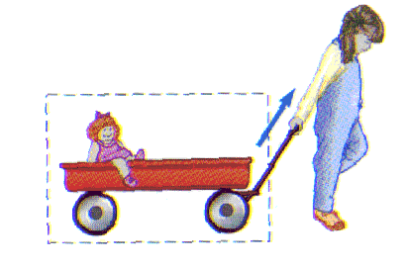
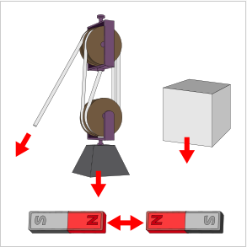
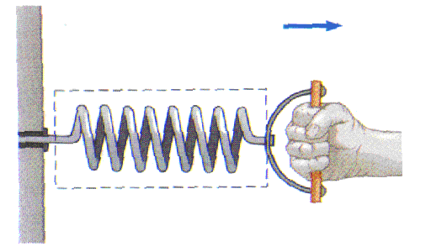
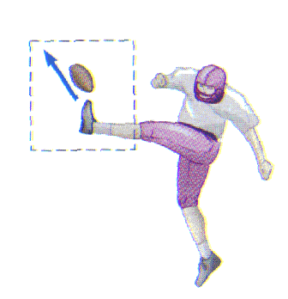
Force
A force is defined as a push or pull due to the interaction between objects which produces or tends to produce motion, stops or tends to stop motion.

Slide 4
Types of forces
All forces between objects can be placed into two broad categories:
  contact force
  contact-less force - forces resulting from action-at-a-distance
Contact forces are those types of forces which result when the two interacting objects are perceived to be physically contacting each other.
E.g: frictional force, tension force, air resistance force, spring force, normal reaction force.
Contact-less forces or action-at-a-distance forces are those types of forces which result even when the two interacting objects are not in physical contact with each other, yet are able to exert a push or pull despite their physical separation.
E.g: gravitational force, electrical force, magnetic force.

Slide 5
Force is a vector
Force is a vector quantity as the direction of a force is important.
The net force on an object is the vector sum of all the forces on that object.
E.g.: A car moving uphill. What are the related forces acting on it?
If we knew the direction and magnitudes on each force, we could work out their combined effect on the car.
Will the car accelerate uphill? Or will it slide backwards down the hill?
The combined effect of several forces is known as resultant force / net force.
Thus, by knowing the resultant force acting on the object, we can calculate the magnitude of its acceleration.
Remember force and acceleration will always acts on the same direction.

Slide 6
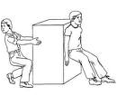

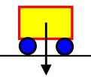



Common Forces
Diagram | Force | Situation
 | Applied force (pushes / pulls). (F) Object can accelerate by pushing or pulling it. | Pushing & pulling. Force of car engine.
 | Gravitation force / Weight. (W) Force of gravity acting on the object. Usually shown by an arrow pointing vertically downwards from object’s center of gravity. | Any object in a gravitational field.
 | Friction. (F_{fr}) Arises when 2 surfaces rub over another. If an object is sliding along the ground, friction acts in the opposite direction to its motion. | Pulling object along the ground. Vehicles cornering or skidding. Sliding down a slope.

Slide 7
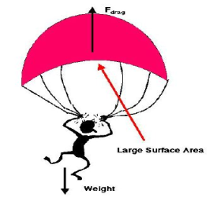
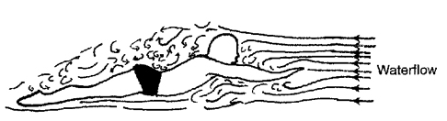


Common Forces
Diagram | Force | Situation
 | Drag / Air resistance / Viscous. (F_{D} or D) When object moves through air / liquid, there is friction between them. Object has to push aside the air/ liquid as it moves along. Drag opposes the motion of object. | Vehicle moving. Aircraft flying. Parachuting. Object falling through air or water. Ship sailing.
 | Upthrust. (U) Object placed in fluid / water experiences an upward force. That’s why something float in water. Upthrust is a vertical upward force acting on a body immersed partially / wholly in a fluid due to the difference in pressure of the fluid.. Deeper you go, greater the pressure. | Boats and iceberg floating. People swimming. Divers surfacing. Hot air balloon rising.

Slide 8
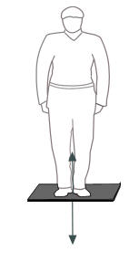
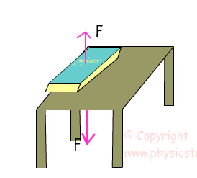
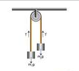

Common Forces
Diagram | Force | Situation
 | Contact Force. (F_{N} or N) Also known as normal reaction force. Always acts at right angles to the surface which produces it. Floor pushes straight upwards. Wall pushes back horizontally. | Standing on ground. Leaning against a wall. Sitting on a chair.
 | Tension. (T) Force on string and spring went it is stretched. If you pull on the end of a string, it tends to stretch. But tension of string will pulls back against you, trying to shorten the string. If you stretch a spring, tension of spring will pull back and try to shorten the spring. If you compress a spring, tension of spring will acts to expand the spring. | Pulling a rope. Compressing or stretching a spring.

Slide 9
Identify Forces
Name these forces
1.) Upward push of water on a submerged object
Upthrust , (U)
2.) Force which wears away two surfaces as they move over one another.
Friction, (F_{fr} )
3.) Force which pulled the apple off Isaac Newton’s tree.
Gravitational Force / Weight, (W )
4.) Force which stops you falling through the floor.
Contact / Normal Reaction force, (F_{N} or N)
5.) Force in a string which holding up a hanging light.
Tension, (T)
6.) Force which makes it difficult to run through shallow water.
Drag / Viscous (F_{D} or D)

Slide 10
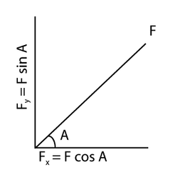
Components of vectors
Force is a vector quantity.
If we have a force, F projected at certain angle, A to the horizontal, we can resolve the force, F into its horizontal and vertical components.
These are:
1.) Horizontal component, Fx = F cos A
2.) Vertical component, Fy = F sin A

Slide 11
Centre of gravity
We have weight because of the gravitational force acting on us.
Each part of our body – arms, legs, and head for example experiences this force.
However, it is much simpler to picture the overall effect of gravity as acting at a single point.
This is our centre of gravity.
The centre of gravity of an object is defined as the point where all the weight of the object may be considered to act.
Centre of gravity of a regular shaped object of uniform weight distribution is easy to find and is usually in the middle.
For irregular objects, it can be found by experiment. (small holes are made around the edge on the irregular objects. A line is drawn on the object along the vertical string of the plumb line. The centre of gravity will be at the point of intersection of the lines drawn.

Slide 12
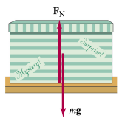
Understanding “Weight & Normal Force”
All objects dropped near the surface of the Earth would fall with the same acceleration, g if air resistance is negligible. The force that cause this fall is called the gravitational force.
Applying the Newton’s 2nd Law to an object of mass m falling freely due to gravity can be written as F_{G} = mg. The magnitude of the force of gravity on an object, mg, is commonly called the object’s weight.
From the 2nd law, the resultant force on an object that remain at rest is simply zero.
Therefore, there must be another force on the object to balance the gravitational force.
For an object resting on the table, the table exerts an upward force. This force that act perpendicular to the common surface of the contact is called the normal force. F_{N}

Slide 13
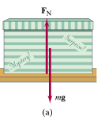

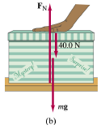
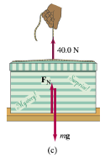
Example 1
W = mg = (10)(9.81) = 98.1 N
F_{N} = mg = 98.1 N
F_{N} = mg + 40.0 = 138.1 N
F_{N} = mg - 40.0 = 58.1 N

Slide 14
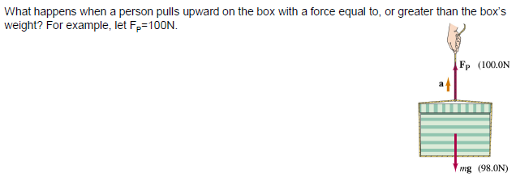
Example 2
F_{N} will be zero as box no longer in contact with table.
If F_{p} > mg, there will be resultant force, box will accelerate.

Slide 15
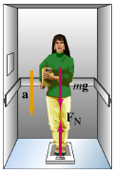
Example 3
a.) W = mg = (65)(9.81) = 637.65 N
F_{Net} = ma
(mg – F_{N}) = ma
(637.65 - F_{N}) = (65)(0.2 x 9.81)
F_{N} = 510.12 N
b.) F_{Net} = ma
(mg – F_{N}) = ma
(637.65 - F_{N}) = 0
F_{N} = 637.65 N

Slide 16
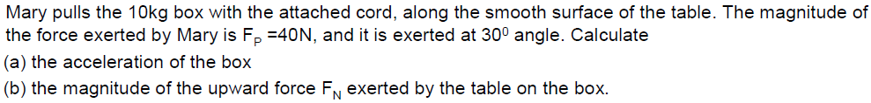
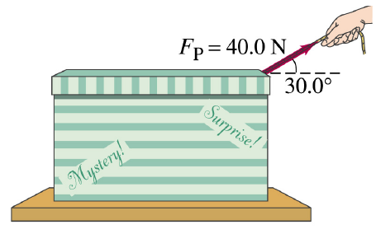
Example 4
a.) F_{p (horizontal)} = 40.0 cos 30° = 34.64 N
F_{Net} = ma
34.64 = (10)a
a = 3.46 ms⁻²
b.) F_{N} = mg - F_{p (vertical)}
= (10)(9.81) – (40.0 sin 30°)
= 78.1 N

Slide 17
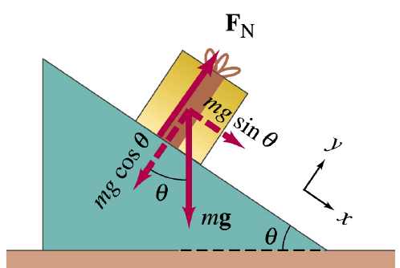
Example 5
A box of mass 10 kg is placed on a smooth (frictionless) incline that makes an angle 30° with the horizontal.
a.) Determine the weight.
b.) Determine the component of weight perpendicular to the incline.
c.) Determine the normal force.
d.) Determine the component of weight parallel to the incline.
e.) Determine the resultant force and the acceleration.
f.) If the incline is rough and has a maximum frictional force of 20 N, determine its resultant force and
acceleration.
W = mg = (10)(9.81) = 98.1 N
mgcos 30° = 85 N
F_{N} = mgcos 30° = 85 N
mgsin 30° = 49.1 N
F_{Net} = ma
(mgsin 30°) = (10)a ; a = 4.91 ms⁻²
F_{Net} = ma
(mgsin 30°- 20) = (10)a ; a = 2.91 ms⁻²

Slide 18
Example 6
Calculate the horizontal and vertical components of a force of 50 N which is acting at 40⁰ to the horizontal.
A body of weight 100 N rests on a plane which is inclined at 30⁰ to the horizontal. Calculate the components of the weight parallel and perpendicular to the plane.
A body of mass 5.0 kg is pulled up a smooth plane inclined at 30⁰ to the horizontal by a force of 40 N acting parallel to the plane. Calculate the acceleration of the body and the force exerted on it by the plane. (assume g = 10 m/s²)
(ans:38.30 N, 32.14 N)
(ans: parallel is 50.00 N, perpendicular is 86.60 N)
(ans: 3 ms⁻², 43.30 N)

Slide 19
Example 7
A boy of mass 40 kg is on a waterslide which has an inclined plane at 30˚ to the
horizontal. The frictional force up the slope is 120 N. Calculate the boy’s
acceleration down the slope.
(Take the acceleration of free fall g to be 9.81 ms⁻²)
( ans: 1.91 ms⁻² )

Slide 20
Example 8
A boy of mass 40 kg is on a waterslide which an inclined plane at 25˚ to the
horizontal.
Calculate the boy’s acceleration down the slope:
(Take the acceleration of free fall g to be 9.81 ms⁻²)
a.) when there is no friction and the only force acting on the child is his weight.
b.) if a frictional force of 80 N acts up the slope.
( ans: 4.15 ms⁻² )
( ans: 2.15 ms⁻² )

Slide 21
Free Body Diagrams
So far we have only seen how forces acting on a single object.
What happens if they are 2 or more objects acting on a given system?
How do we analyse the forces acting on each body and the perhaps the acceleration as well?
We can do so by applying the idea of “free-body diagrams” .
Free body diagrams are diagrams used to show the relative magnitude and direction of all forces acting ON an object in a given situation.

Slide 22
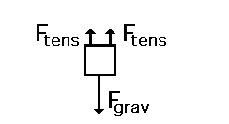
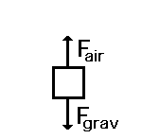
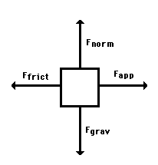
Examples of Free Body Diagram
A box is suspended motionless from the ceiling by two ropes. A free-body diagram for this situation looks like this.
A skydiver is descending with a constant velocity. Consider air resistance. The forces acting upon the skydiver are shown as below
A car which is moving with a constant speed on a rough ground. A free-body diagram for this situation looks like this.

Slide 23
Free body Diagram – Problem Solving
How to start you mind thinking and getting involved in the problem at hand.
1.) Draw a sketch of the situation.
2.) Consider only one object (at a time), draw a free body diagram for that body, showing ALL forces acting ON that object only, including the unknown force that you have to solve for.
3.) DO NOT show any forces that the body exerts on other bodies.
Label each force as to its source (gravitational, friction, etc).
4.) Only forces acting ON the given object can be included in the ∑F = ma for that particular object.

Slide 24

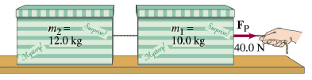
Example 9
a.) F_{Net} = ma
40 = (22)a ; a = 1.82 ms⁻²
b.) Consider m₂
F_{Net} = ma
T = (12)(1.82) = 21.8 N
b.) Consider m₁
F_{Net} = ma
(F_{p} – T) = (10)(1.82)
(40.0 – T) = 18.2
T = 21.8 N
OR

Slide 25

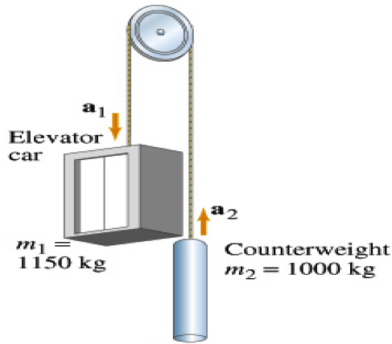
Example 10
a = 0.68m/s²
T = 10, 500 N

Slide 26
Example 11
2 boxes are connected by a cord running over a pulley. The friction on box 1 = 9.8 N.
Assuming mass of cord as well as friction at pulley is small and negligible.
a.) Find the acceleration of the system. (assuming the cable doesn’t stretch)
b.) The tension of the cable.
5.0 kg
box1
a = 1.4 m/s²
T = 17 N
box2
2.0 kg

Slide 27
System in Equilibrium
Two conditions for system in equilibrium:
1.) Resultant forces in any direction must be equal to zero.
(Equilibrium of Forces)
2.) Resultant moments about any point must be equal to zero.
(Equilibrium of Moments)
Why?
  The forces on it must balance, otherwise they would cause translational motion (from one place to another)
  The moments must balance, otherwise they would cause rotational motion
(turning)

Slide 28
1st Condition: Equilibrium of Forces
Equilibrium of forces means the resultant of all the forces acting on the system is ZERO in any direction. ( F_{resultant} = 0 )
In other words, a body is said to be in translational equilibrium if the resultant of all the forces acting on the body is zero.
How do we determine then?
a.) Mathematically, resolve all vectors to horizontal and vertical components.
If the resultant force horizontally is zero & resultant force vertically is also zero, then we
conclude that system is in translation equilibrium.
b.) By drawing a vector addition diagram.
For an equilibrium of forces the vector addition of the forces must yield a closed polygon
regardless of how many forces are there. (the vectors must all point in one direction!)
To do this accurately, it would required proper scale and correct angle.
F1
F2
F1
F3
F3
F2

Slide 29
Example 12
The below system is in equilibrium. Find the tension of T1 & T2 in the cords supporting the object of weight 100N.
Vertical component : T1 (sin 45) = 100N
Horizontal component : T1 (cos 45) = T2
45°
T1
T2
100 N
( ans: 141.4 N )
( ans: 100.0 N )

Slide 30
Example 13
The free body diagram below shows 3 forces that act on a box hanging at rest from 2 strings.
Calculate horizontal & vertical component of each string tension.
Calculate the weight of the box.
Draw a vector diagram of the forces on the box. Is it a closed polygon?
Use your vector diagram to calculate the weight of the box.
T1 = 1.00N
T2 = 0.58N
60°
30°
Horizontal
Weight of box

Slide 31

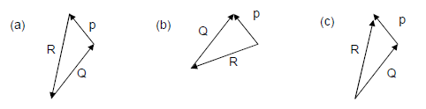
Example 14

Slide 32
Moment of a force
The 2nd condition for a system to be in equilibrium is that the resultant moment about any point must be zero.
In other words, the resultant rotational motion must be zero. ( Moment_{resultant} = 0 )
But first of all, let us learn what moment is and the equation related to it.
Force can make things accelerate. They can also make things turn around.
The turning effect cause by a force is the quantity we called moment.
Example of a spanner turning a nut.
Moment of force depends on 2 quantities:
1.) the magnitude of force
2.) the perpendicular distance of the force from the pivot
Pivot is basically the axis / centre point of which the mechanism rotates or turn.
Moment = force x perpendicular distance of the pivot from the line of action of the force

Slide 33
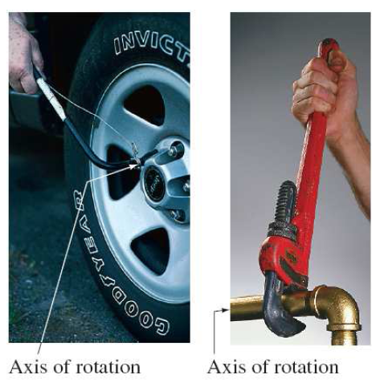
Moment of a force
Unit of moment is Newton metre (Nm).
It is a vector quantity.
Diagram | Type of Moments | Sign Convention (usually)
 | Anti-clockwise | Positive (+)
 | Clockwise | Negative (-)
Pivot
F
d
d
F
Pivot

Slide 34
Moment of a force
Calculate the moment of force respectively..
A.)
B. )
0.2 m
Pivot
( ans: 3.0 Nm )
F = 15 N
0.2 m
Pivot
50°
( ans: 2.3 Nm )
F = 15 N

Slide 35
Principle of moments
We can use the idea of moment of a force to solve 2 sorts of problem.
1.) Check whether object will remain balanced or start to rotate.
2.) Calculate the unknown force or distance if knowing the object is balanced.
To solve problems above, we need to know the principle of moments.
Principle of moments states that for any object that is in equilibrium, the sum of the clockwise moments equals the sum of the anticlockwise moments about any point provided by the force acting on the object.
This is the 2nd condition for system in equilibrium.

Slide 36
Example 15
Calculate the moment of each force about point P. (F1, F2, F3, F4)
State whether each moment is clockwise or anticlockwise.
Are the moment of forces balanced ?
F1 = 0Nm, F2 = 2.5Nm (cw), F3 = 2.5Nm (cw), F4 = 5Nm (acw)
Yes, moments of forces are balanced.
F4 = 5N
F1 = 10N
25 cm
25 cm
50 cm
P
30°
F3 = 10N
X
F2 = 10N

Slide 37
Example 16
Calculate T.
sum of CW moment of forces = 20 x 0.5 = 10Nm
sum of ACW moment of force = T x (1sin40)
T x (1sin40) = 10 ; T = 15.6N
T = ?
40°
P
50 cm
50 cm
W = 20N

Slide 38
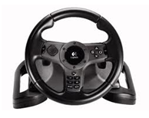
A Special Pair of Forces called
COUPLE
A couple is defined as a pair of equal and opposite forces which are parallel and whose lines of action do not coincide.
Acting on an object, a couple produces rotation.
Figure above shows the forces needed to turn a car’s steering wheel. The 2 forces of 20N up and 20N down will have a turning effect on the wheel. The wheel is not in equilibrium because the pair of forces cause it to rotate.
A pair of force like this is known as a couple.
20 N
20 N

Slide 39
Couple
To form a couple, the 2 forces must be equal in magnitude, parallel but opposite direction, and separated by some distance (d)
Since a couple would cause rotation, thus the turning effect caused by it is known as torque.
Generally, the torque of a couple = one of the forces x perpendicular distance between forces
Take note that:
1.) Moment of a single force depends on the point or pivot about which the
moment acts. Further the force is from the pivot, greater the moment.
2.) The torque of a couple only depends on the perpendicular distance
between the 2 forces. It does not depend on the point which it acts.

Slide 40
Example 17 (Moment & Couple)
Find the moment of a 10 N force about a point O in which its perpendicular distance from the point of action of the force is 4.0 m
Moment about O = force x perpendicular distance of the pivot from the
line of action of the force
= 4 x 10
= 40 Nm
Find the torque due to a 20 N couple about an axis through O which is 2.0 m from one of the forces and 4.0 m from the other. The lines of action of the couple are perpendicular to the distance between the forces.
Torque = one of the forces x perpendicular distance between forces
    = 20 x 6
    = 120 Nm

Slide 41
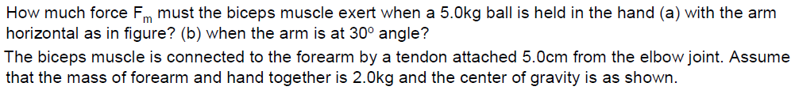
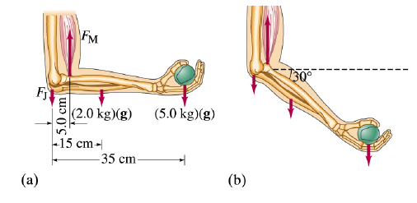
Example 18
(a)
(b)
CW moment = Anti CW moment
(2 x 9.81)(0.15) + (5 x 9.81)(0.35) = F_{M} (0.05)
F_{M} = 402.21 N
CW moment = Anti CW moment
(2 x 9.81)(0.15)(cos30°) + (5 x 9.81)(0.35)(cos30°) = F_{M} (0.05)(cos30°)
F_{M} = 402.21 N

